Slide 1
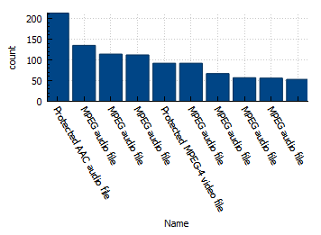
What is the most common media type used by artists
<visualization>
Protected AAC audio file is the most common media type used by iron maiden.

Slide 2
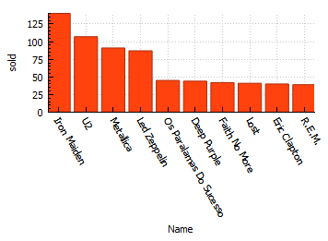
Who is the artist that sold copies?
<visualization>
Iron maiden band is the one that sold the most, from 5 to 10 we can see that they close to each other

Slide 3
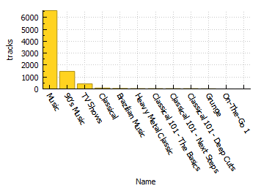
What is the playlist that contain tracks?
<visualization>
Music playlist is significantly the highest with more than 6000 tracks.

Slide 4
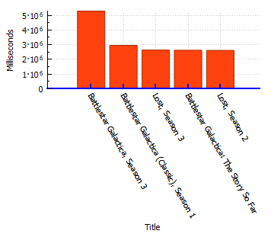
what is the longest track?
<visualization>
Battlestar Galactica, Season 3 album is the longest ,
Lost, Season 3, Battlestar Galactica: The Story So Far and Lost, Season 2 are nearly the same milliseconds

